Slide 1
Big Desire to Share Big Health Data:
A Shift in Consumer Attitudes toward Personal Health Information
K. Thomas Pickard and Melanie Swan
2014 AAAI Spring Symposium Series
Stanford University
March 26, 2014

Slide 2
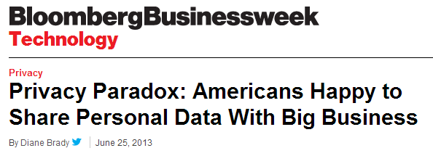

“Given the choice between pizza and privacy…a remarkable number will opt for the pizza.”

Slide 3
What did we do?
Online survey to gauge consumer attitudes toward sharing health information
Period: July 30, 2012 to April 30, 2013
128 respondents and >7,900 data points
27 questions

Slide 4
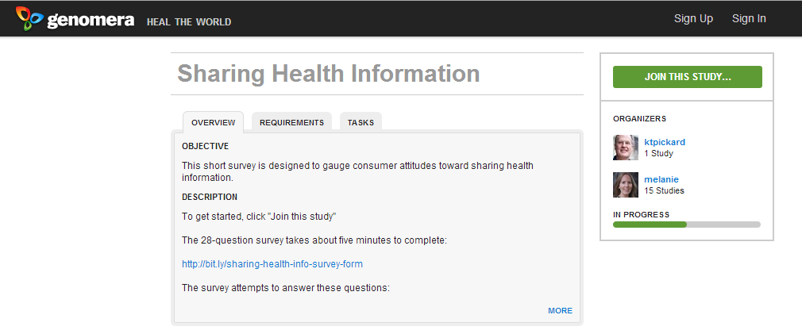
Genomera: Health collaboration

Slide 5
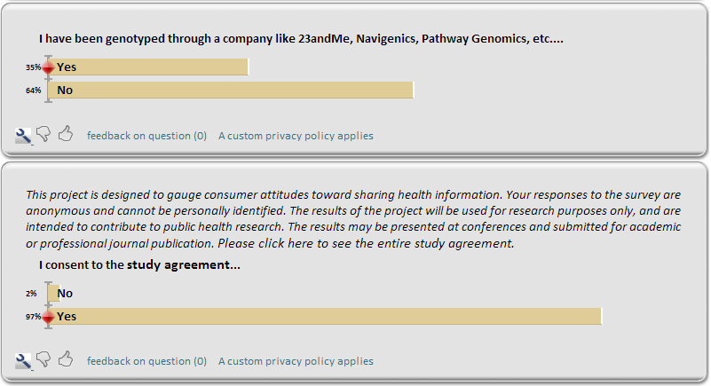
Traitwise: Survey platform

Slide 6
Why did we do this?
Learn more about healthcare research
Answer some questions:
  1. Are consumers willing to share genomic, medical and health tracking information for research purposes?
  Do consumers have interest in receiving recommendations based on shared personal health information?

Slide 7
Willing to share…
95% responded “Yes” or “In some cases.”

Slide 8
What would I share?
Diet (88%)
Exercise (88%)
Traits (85%)
Diseases and conditions (81%)
Genomic data (80%)
Fitness tracking information (80%)
Medications (79%)
Environmental factors (78%)
Electronic medical records (72%)
Other (27%)
The average across all data types was 76%.

Slide 9
Our sample was WIRED
64% of respondents reported owning one or more tracking devices.

Slide 10
Would I share irreversibly anonymized data?
71% are willing to share irreversibly anonymized information.

Slide 11
Would I share identified data?
68% would share fully identified information in some cases.

Slide 12
I want to know…
Actionable things I can do to improve my health (93%)
My likelihood to develop a disease (86%)
What others like me are doing to stay healthy (82%)
My current state of health (81%)
My health relative to peers or others (71%)
How my health may affect my children (62%)
Other (17%)

Slide 13
What’s my motivation?
Make new health discoveries (88%)
Learn more about personal health risks (82%)
Desire to change current system (73%)
Health condition (66%)
Learn more about my ancestry (31%)
Want something in return (15%)
Bragging rights (11%)

Slide 14
Who should control access?
Myself (69%)
Non-profit organizations (45%)
Universities and academic institutions (38%)
National databanks (34%)
Government (25%)
For-profit companies (6%)
Insurance companies (3%)

Slide 15
What are the barriers to sharing?
Privacy concerns (85%)
Lack of awareness of value of contribution (77%)
Concern about data being used for profit (58%)
No easy way to share data (45%)
Other (13%)

Slide 16
What am I concerned about?
Insurance discrimination (67%)
Personal or family privacy (43%)
Employment discrimination (40%)
Racial discrimination (11%)
Other (20%)

Slide 17
Give data. Get feedback…
Respondents are more likely to share if they receive personalized recommendations based on discoveries made from their data.

Slide 18
And I would pay for it…
Non-profit organization with recommendations based on scientifically validated algorithms (63%)
Physician or healthcare provider (59%)
Genetic counselor (52%)
For-profit company with recommendations based on scientifically validated algorithms (40%)

Slide 19
Limitations?
Internet connectivity
Convenience sample (n=128)
Education level

Slide 20
Our sample was educated
Sample: 59% of respondents have Master’s level education or higher.
US average: 10% have Master’s level education or higher.

Slide 21

Can I replicate the results?
Order details:
Responses: 101/101
Ordered: February 23 2014
Completed: February 23 2014
Price: $205.00
Target Market:
Country: United States
Language: English
Gender: Males and Females
Age Range: 18 - 65+ years old
Ethnicity/Race: Any
HH Income: $0 to $500k+
Education: Any
Employment: Any
Career: Any
Relationship: Any
Parental status: Any
Location: Any
20% had Master’s level education or higher

Slide 22
Similar results
Answer | Resp. (101)
A1: Yes | 40.5% (41)
A2: No | 10.8% (11)
A3: In some cases | 48.5% (49)
I am willing to share my health and medical information...

Slide 23
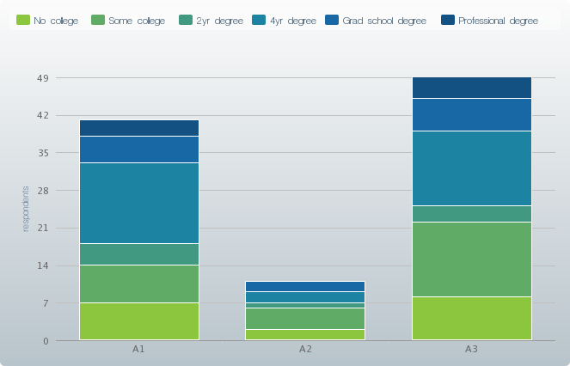
Education seems to play a strong role…
In the “No” category, 63% of respondents reported having less than 4 year degree.

Slide 24
Conclusions
Consumers are willing to share health data under the right conditions.
Education seems to play a strong role.
Consumers want to be connected to their data.
Develop models to encourage sharing.

Slide 25
Health Information Sharing Model
Consumer
Trust
Motivation
Community
Informed Consent
Notes:
Trust addresses access control issues; motivation explains consumer eagerness and willingness to share; community incorporates social aspects of sharing; and informed consent such as Portable Legal Consent provides the legal constructs necessary to safeguard privacy.

Slide 26
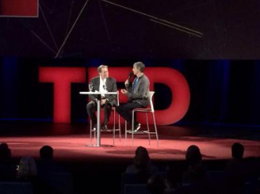
Final thought…
“Wouldn’t it be amazing to have anonymous medical records available to all research doctors?” – Larry Page
Image credit: Daniel Kraft

Slide 27


Acknowledgements
Greg Biggers – Genomera
Rechelle Fryklund and Michael Simpson – Traitwise
Takashi Kido – Riken Genesis Co., Ltd., Japan
We also would like to acknowledge and thank the survey respondents for their participation.

Slide 28
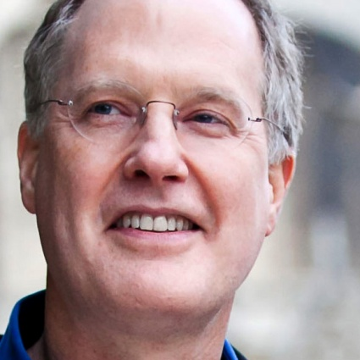
Questions?
K. Thomas Pickard
ktpickard [at] startcodon.org
@kthomaspickard
www.linkedin.com/in/kthomaspickard
Disclosure statement: Nothing to disclose
Paper: http://bit.ly/share-big-health-data-paper
Survey: http://bit.ly/sharing-health-info-survey-form

