Slide 1
What happened to my chart at the doctor's office?
K. Thomas Pickard
August 30, 2011

Slide 2

Medical record: 15,000 years ago.
Source: http://www.lascaux.culture.fr

Slide 3
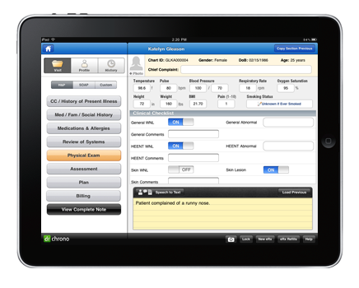
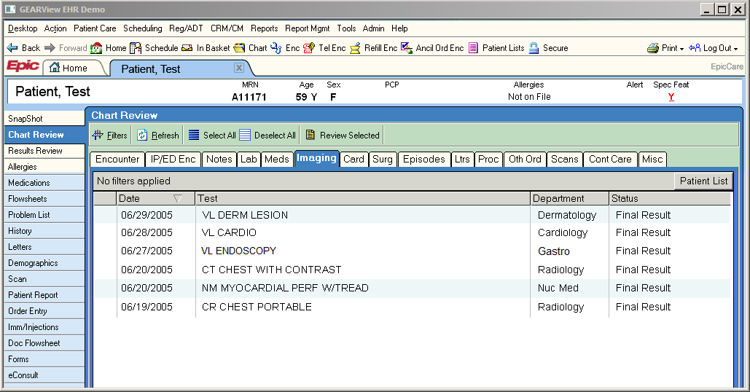
What is an EHR?
Electronic Health Record
Same as EMR – Electronic Medical Record
Replaces paper chart
Better access to medical history

Slide 4
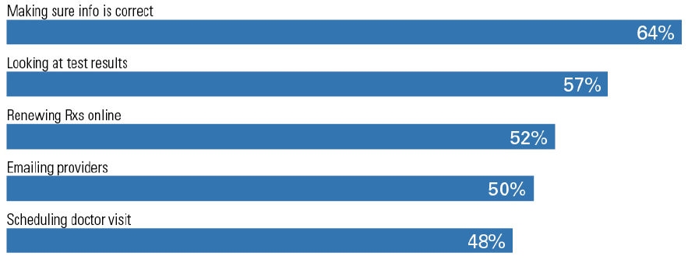
What do people want from the EHR?
Source: California HealthCare Foundation, April 2010

Slide 5
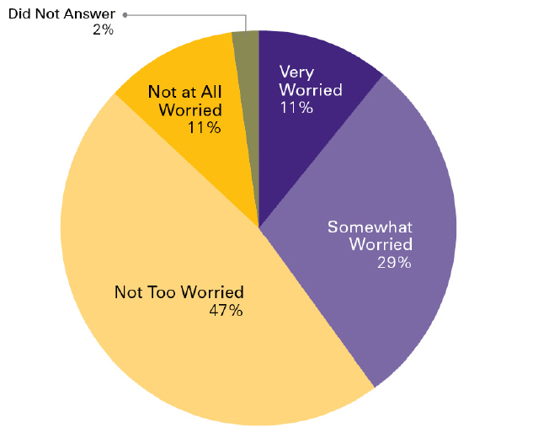
Are EHR users worried about privacy?
Source: California HealthCare Foundation, April 2010

Slide 6
What about non-users?
75% worried about privacy
57% would sign-up if they trusted the organization
54% strong laws and fines matter
52% would do it if the doctor said it was safe
Source: California HealthCare Foundation, April 2010

Slide 7
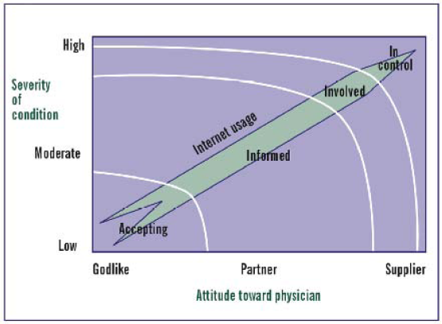
How do you relate to your physician?
Source: Carina Von Knoop, BCG

Slide 8
Your privacy: HITECH Act of 2009
Health Information Technology for Economic and Clinical Health
Part of Reinvestment Act (ARRA)
Expands HIPAA privacy and security
Stronger penalties for data breaches

Slide 9

How are we moving to EHRs?
ARRA Incentive: $19.2 billion
Medicare: $44,000 per physician over five years
Carrot: Must start by end of 2011
Stick: 2015 and later, penalties
Source: HHS https://www.cms.gov/EHRIncentivePrograms/

Slide 10
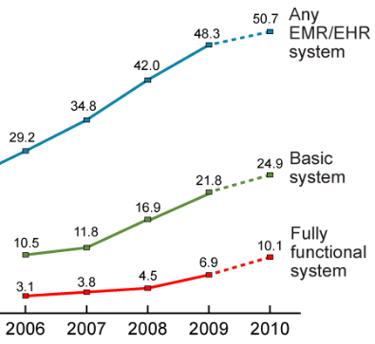
Hospitals and physicians are quickly adopting EHRs.
50% nationwide
70% in California
80% in Gilroy!
Source: CDC http://www.cdc.gov/nchs/data/hestat/emr_ehr_09/emr_ehr_09.htm

Slide 11
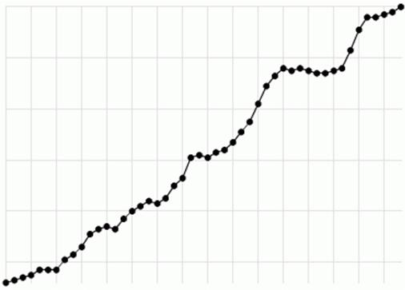
How expensive is healthcare?
We spend $2.5 trillion annually
About 17% of GDP today
16%
% GDP
5%
1960
2007
Source: OECD data, Timeshifter

Slide 12
How much money will EHRs save?
$80 billion per year (Hillestad/RAND, 2005)
  Direct clinical savings
Infrastructure to go after $700 billion (Thomson Reuters/BCG, 2009)
Estimated waste (billions) | Reason
$270 | Overtreatment
$140 | Fraud and abuse
$120 | Administrative inefficiencies
$90 | Provider inefficiency and errors
$40 | Lack of care coordination
$40 | Preventable conditions

Slide 13
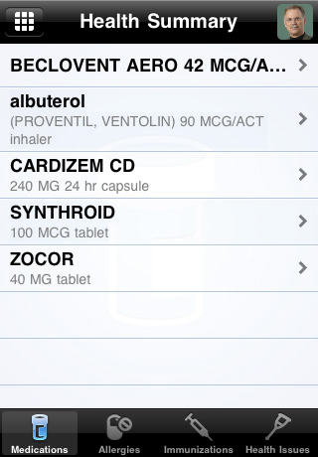
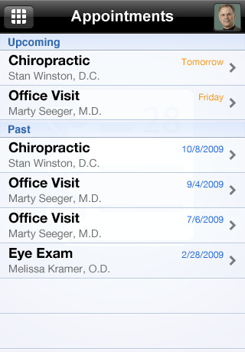
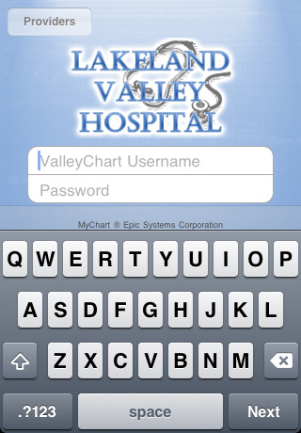
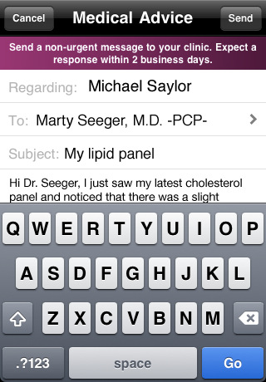
The Personal Health Record (PHR)
Source: Epic Systems, MyChart

Slide 14
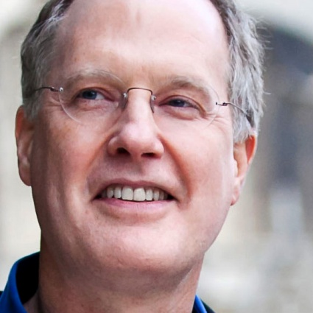
Questions?
KT Pickard
@kt_pickard
linkedin.com/in/ktpickard
Disclosure statement: Nothing to disclose

