Slide 1
Exploring Markets of Data for Personal Health Information
K. Thomas Pickard
ICDM 2014: Designing the Market of Data - for Practical Data Sharing via Educational and Innovative Communications
December 14, 2014

Slide 2

How I got here

Slide 3
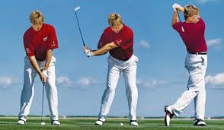
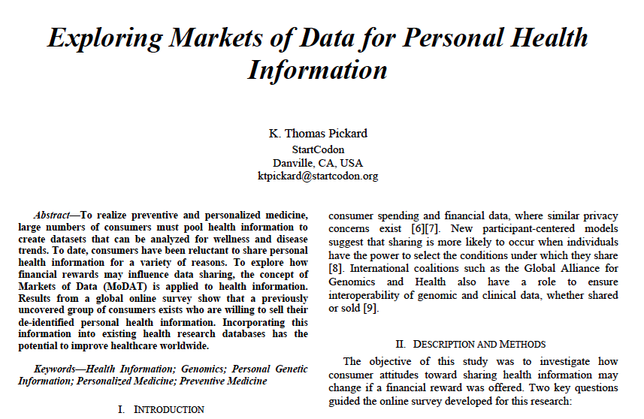
My passion
Not golf
Research about health information sharing

Slide 4
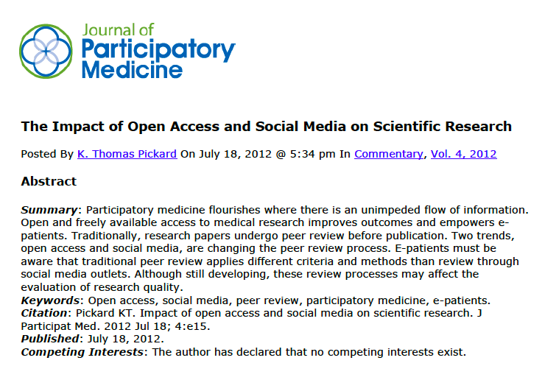
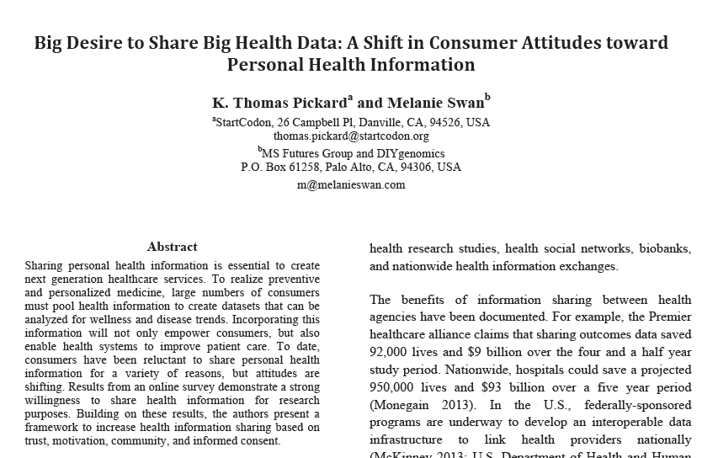
Why health information sharing?
Implications for improving health

Slide 5
Two examples
Rare diseases
Common diseases

Slide 6

Meet the Beery’s
Source: http://www.nature.com/news/2011/110615/full/news.2011.368.html

Slide 7
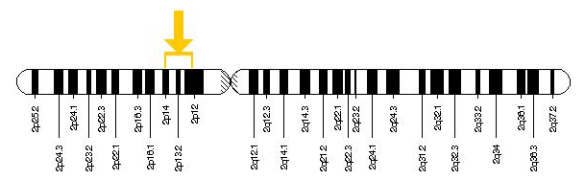
DNA sequencing finds rare disease
Dopa-responsive dystonia in children
Mom read about condition in newspaper
Single change on SPR gene
Improved with serotonin therapy
SPR
Chromosome 2

Slide 8
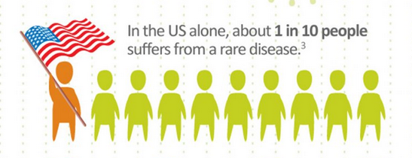
Rare disease in U.S.
Defined to be 1 in 1,500 people
Source: https://www.govtrack.us/congress/bills/107/hr4013

Slide 9
30M rare disease patients in U.S.
Another ~3,700 single-gene diseases suspected
3,500 single-gene diseases identified
Source: http://www.ncbi.nlm.nih.gov/pubmed/23504071

Slide 10
95% of rare diseases have no FDA approved drug
Source: http://globalgenes.org/rare-diseases-facts-statistics/

Slide 11



Implications
Rare disease networks
Sharing eliminates guesswork
Solve more cases
→ What about common diseases?

Slide 12
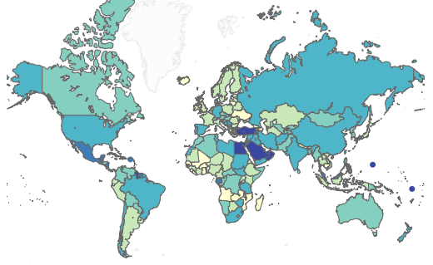
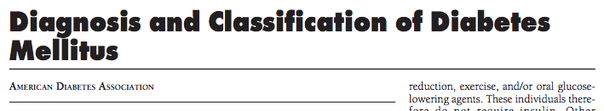
Diabetes
Disease prevalence:
  World: 4% to ~40%
  U.S.: ~10%
Disease types: 30+
U.S.: ~30M people → 30 types → 1M per type
Sources:
  http://care.diabetesjournals.org/content/29/suppl_1/s43.full.pdf
  http://healthintelligence.drupalgardens.com/content/prevalence-diabetes-world-2013

Slide 13

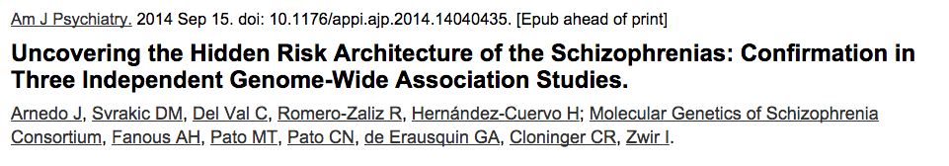
Schizophrenia
Disease prevalence:
  World: ~1% (with little variation)
Disease types: 7 or more
U.S. ~3.5M people → 7 types → 500k per type
Nobel laureate John Nash
Source: http://www.ncbi.nlm.nih.gov/pubmed/25219520

Slide 14
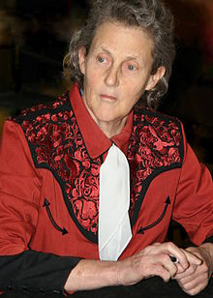

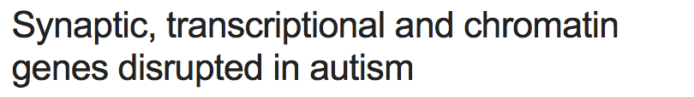
Autism spectrum disorders
Disease prevalence:
  World: ~1%
10% explained by genetics
  U.S. 2M people → > 6 types → ~300k per type
Autistic activist Temple Grandin
Sources:
  http://www.cdc.gov/ncbddd/autism/documents/asd_prevalence_table_2013.pdf
  http://www.nature.com/nature/journal/v515/n7526/full/nature13772.html

Slide 15
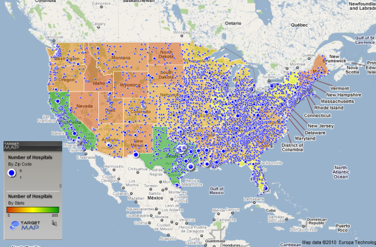
Hospitals and patients
U.S. hospitals:
  ~6,000 facilities
U.S. population: ~320M people
→ One hospital per 50,000 people
Source: http://www.targetmap.com/viewer.aspx?reportId=3065

Slide 16
Patients per U.S. hospital
1M diabetes patients
    170 patients per hospital → 1 in 300
500k schizophrenic patients
    80 patients per hospital → 1 in 625
300k autism spectrum disorder patients
    50 patients per hospital → 1 in 1,000
→ Rare disease: 1 in 1,500
Source: http://www.cdc.gov/datastatistics/

Slide 17
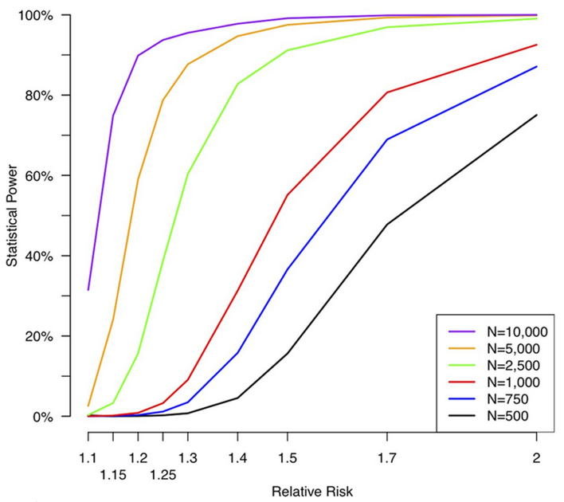
Implications
Complex and rare disease can look similar
Hospitals must share to solve diseases
5,000 people with a disease are necessary for good genomic results
Source: http://jbjs.org/content/96/5/e38

Slide 18

A shift in consumer attitudes

Slide 19
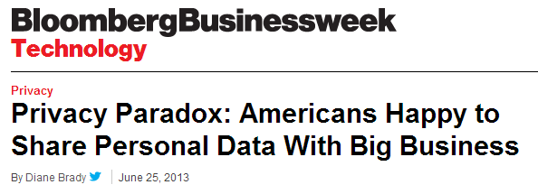

“Given the choice between pizza and privacy…a remarkable number will opt for the pizza.”

Slide 20
Insights
Consumers are willing to share health data under the right conditions.
Education seems to play a strong role.
Consumers want to be connected to their data.
Develop models to encourage sharing.

Slide 21
Health Information Sharing Model
Consumer
Trust
Motivation
Community
Informed Consent
Notes:
Trust addresses access control issues; motivation explains consumer eagerness and willingness to share; community incorporates social aspects of sharing; and informed consent such as Portable Legal Consent provides the legal constructs necessary to safeguard privacy.

Slide 22

Can we go faster with MoDAT?
Markets of Data (MoDAT)
Will consumers share if paid?
Online survey
400 participants
7 questions
Ask Your Target Market (aytm.com)

Slide 23
A global survey
Responses by Continent
  Asia (40%)
  Europe (35%)
  North America (17%)
  Africa (5%)
  Oceania (2%)
  South America (2%)
59 countries represented

Slide 24
Willing to share
When asked about sharing, 88% responded “Yes” or “In some cases.”

Slide 25
Share with financial reward

Slide 26
Share/Sell Data Types

Slide 27
Share/Sell with…

Slide 28
Financial Reward vs Difference in Average Number of Items Selected

Slide 29
Household Income
Over half of the respondents reported a household income of less than $25,000 USD.

Slide 30
One-time payment

Slide 31
Age: Sample vs World
Age ranges from 18 to 74.
Average age cohort is 30-34 years.
Source: U.S. Census Bureau, 2014 World Midyear Population by Age

Slide 32
Age and reward
R² = 0.87

Slide 33
Age and one-time payment

Slide 34
GDP and one-time payment
Croatia
Romania
Philippines
Malaysia
Poland
Indonesia
India
Italy
United Kingdom
Source: United Nations 2012 GDP Data

Slide 35
Limitations
Paid to participate
Convenience sample (n=400)
Education level

Slide 36
Our sample was educated
64%
Completed at least four years of college
vs
25%
Global tertiary education enrollment average
Source: UNESCO Institute for Statistics in EdStats. “Teritary education – A global report,” 2012.

Slide 37


Summary
Rare and complex diseases can look similar
Share health information to solve disease
Some consumers view sharing health information like a “free pizza”
Free!

Slide 38
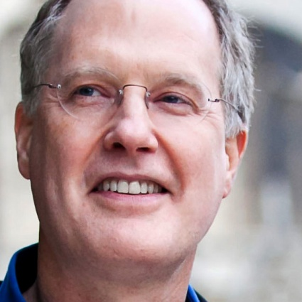
Thank you
K. Thomas Pickard
ktpickard [at] startcodon.org
@kthomaspickard
www.linkedin.com/in/kthomaspickard
Blog: www.genomedad.com

