Slide 1
Restless Legs Syndrome and Niacin
K. Thomas Pickard
Quantified Self Show&Tell #21
San Francisco, CA
October 27, 2011

Slide 2
What is Restless Legs Syndrome (RLS)?
Uncomfortable/unpleasant sensations in legs
Often with periodic limb movements of sleep (PLMS)
Symptoms usually worse at night
Affects 5–15% of the population

Slide 3
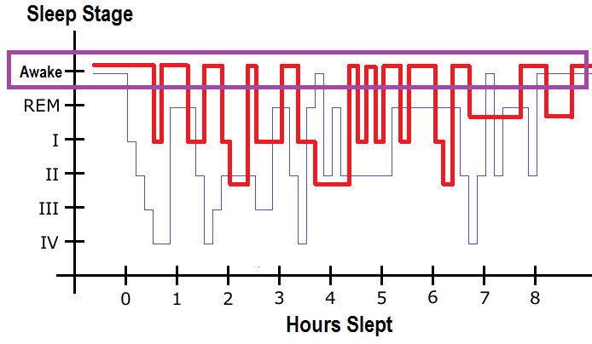
What can RLS look like?
RLS Patient
Healthy Sleep Pattern
Source: Markus Mueller, RLS, Wikipedia

Slide 4
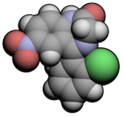
Restless Legs Syndrome and me
Had it since early 20’s
Diagnosed at age 38
Taking clonazepam 0.5 mg/day
Started with 2.5 mg/day (!)
clonazepam

Slide 5
Some previous work
“Drug” experiments (2002-2009)
MBA and $1000 genome (2009)
Coriell Personalized Medical Collaborative (2009)
23andMe (2011)

Slide 6
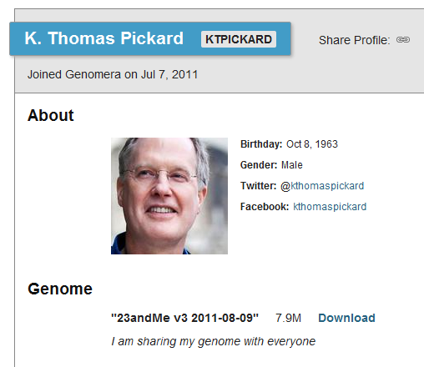

Genomera: QS + genomics
Crowd-sourcing health discovery
Genomics meets Facebook
I am sharing my genome with everyone
Source: www.genomera.com/users/ktpickard

Slide 7

RLS/niacin study protocol
Seth Roberts: blog post on RLS and niacin
0 to 1000 mg/day niacin over four weeks
Track “flush,” RLS and PLMS severity, sleep hours daily
Check cholesterol before and after (HDL benefit from niacin)
Niacin – Vitamin B3

Slide 8
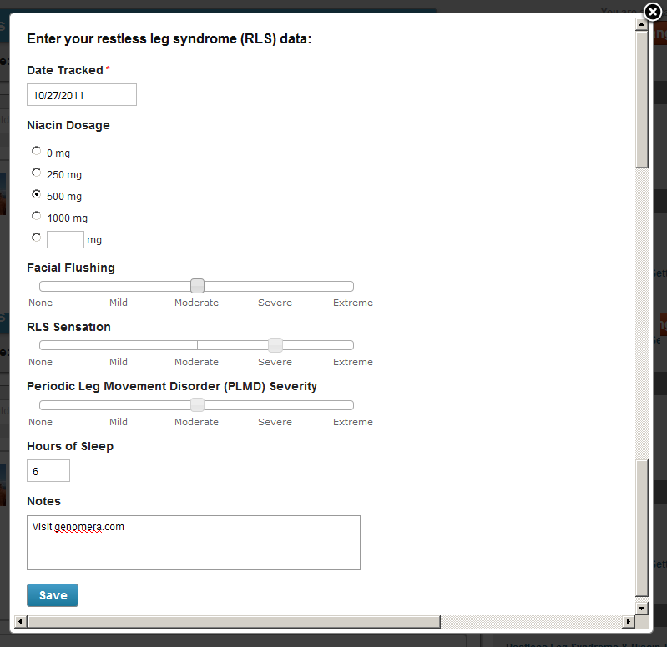
“Instruments” on Genomera
Niacin Dosage
Facial Flushing
RLS Sensation
Source: www.genomera.com/studies/effects-of-niacin-on-restless-leg-syndrome

Slide 9
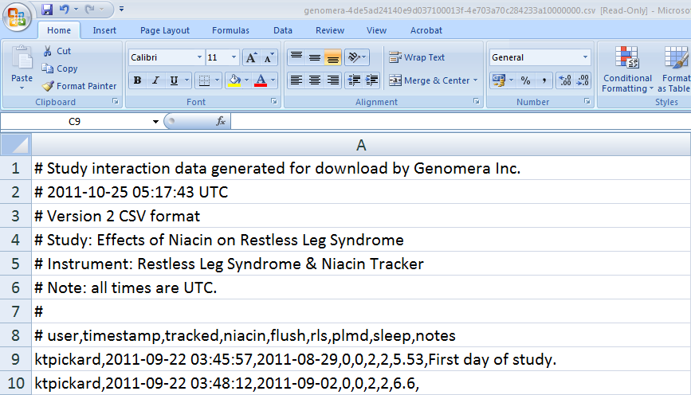
Data sharing on Genomera
Source: www.genomera.com/studies/effects-of-niacin-on-restless-leg-syndrome

Slide 10

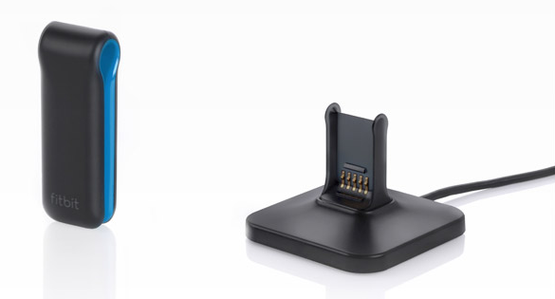
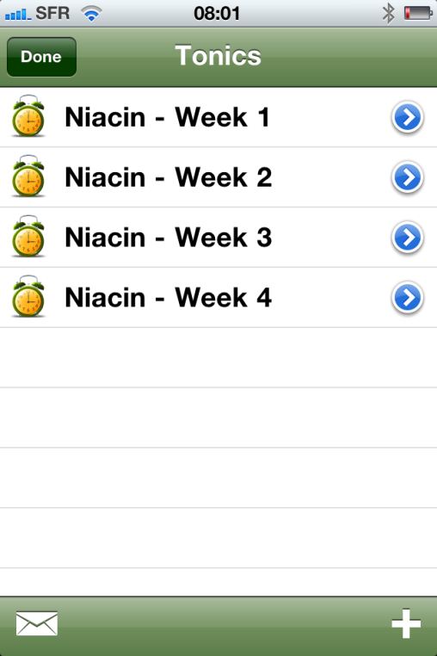

I used some other instruments, too.
For measuring sleep
For niacin reminders
Sources: www.fitbit.com, www.tonicselfcare.com

Slide 11
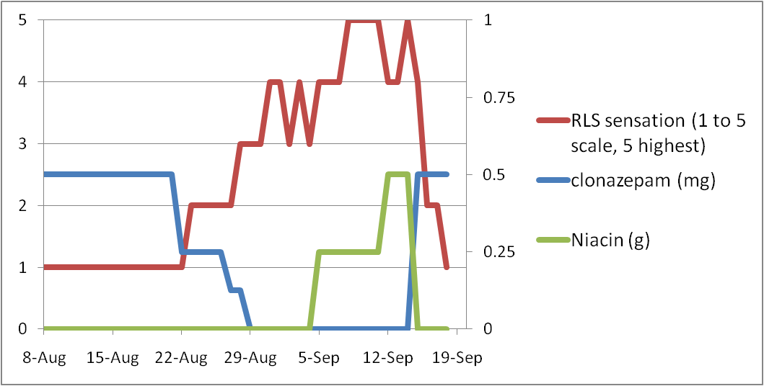
Meds go down, symptoms go up
Source: bit.ly/pT1zok

Slide 12
Meds go down, symptoms go up
Source: bit.ly/pT1zok

Slide 13
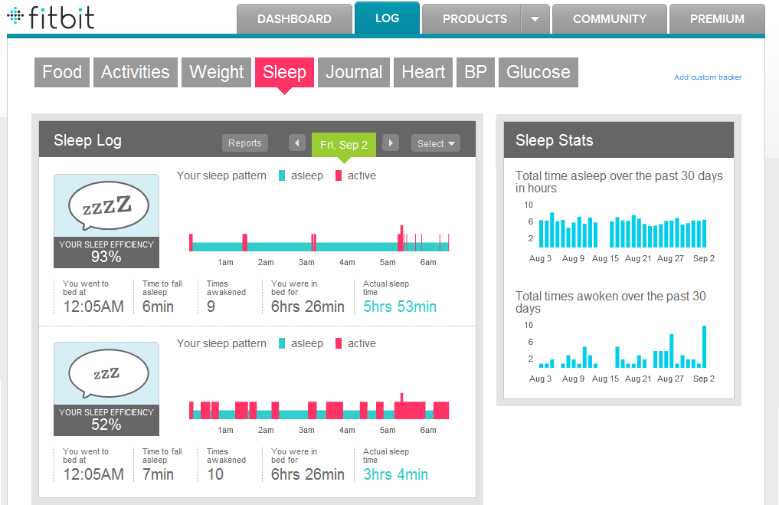
How well am I really sleeping?
Normal tracking
Sensitive tracking
Lost fitbit in washing machine

Slide 14
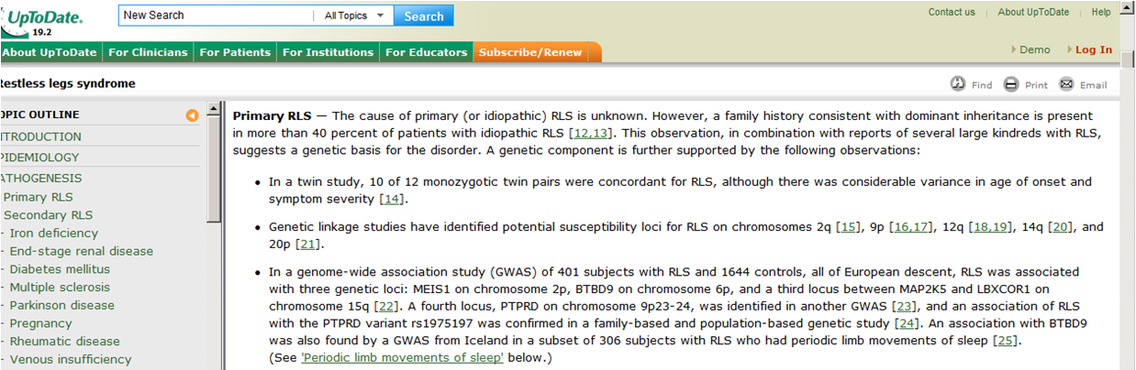
Talking about RLS with my doctor
23andMe RLS variant: rs3923809 (AG)
UpToDate.com – has GWAS info!
“Let’s check your serum ferritin level.”

Slide 15

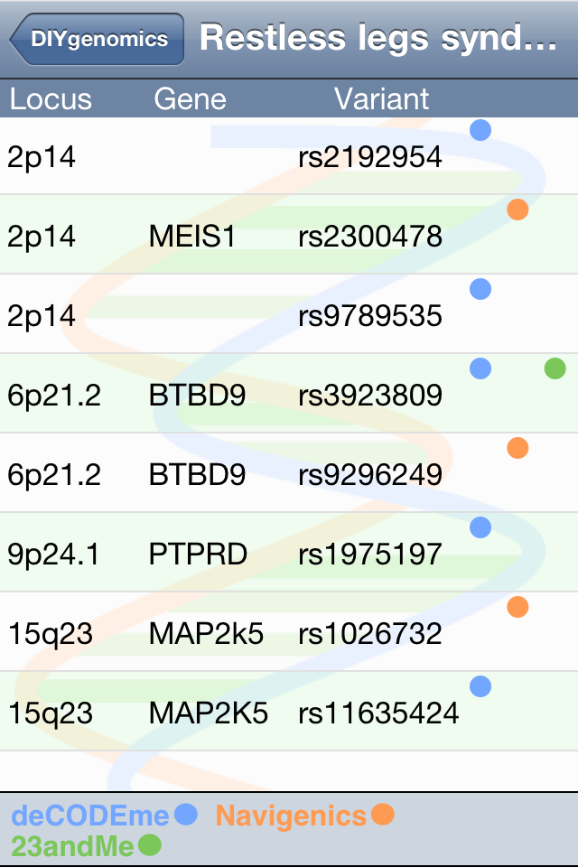
RLS and genetic factors
Dominant inheritance: 40%
Recent 23andMe RLS update
For me—mixed results:
2 higher-risk markers
1 lower-risk marker
3 typical markers
Source: www.diygenomics.org

Slide 16
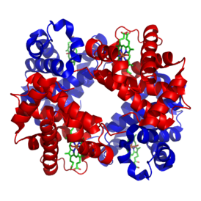
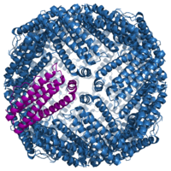
What about ferritin?
Hemoglobin carries O₂ in blood
    13.8–18 g/dL for males
    12.1–15.1 g/dL for females
My hemoglobin: 15–16 g/dL
Ferritin stores iron
  30–400 ng/mL for males
  13–150 ng/mL for females
My ferritin: 14 ng/mL
Hemoglobin
Ferritin

Slide 17
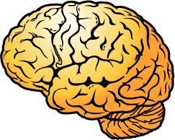
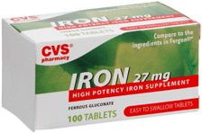
What’s the theory?
RLS patients may have diminished brain iron stores
Tested with CSF, MRI, US, autopsy
Iron therapy may improve symptoms
?
+
=
RLS
Source: www.rls.org/Document.Doc?&id=605

Slide 18
What did I learn?
Niacin did not improve my RLS
Low ferritin may be the cause
Work with a quant-friendly doc
QS can be uncomfortable
New talk if iron therapy works

Slide 19
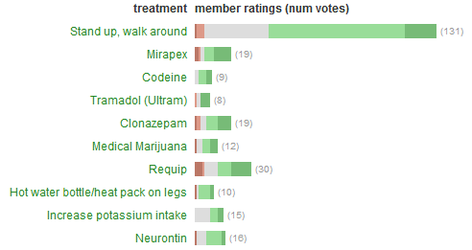
For more information
RLS
  www.rls.org
National Sleep Foundation
  www.sleepfoundation.org/article/sleep-related-problems/restless-legs-syndrome-rls-and-sleep
CureTogether
  www.curetogether.com
Source: www.curetogether.com

Slide 20

Questions?
KT Pickard
@kt_pickard
linkedin.com/in/ktpickard
Disclosure statement: Nothing to disclose

