Slide 1
Restless Legs Syndrome and Niacin – Part 2
K. Thomas Pickard
Quantified Self Show&Tell #28
San Francisco, CA
December 5, 2012

Slide 2
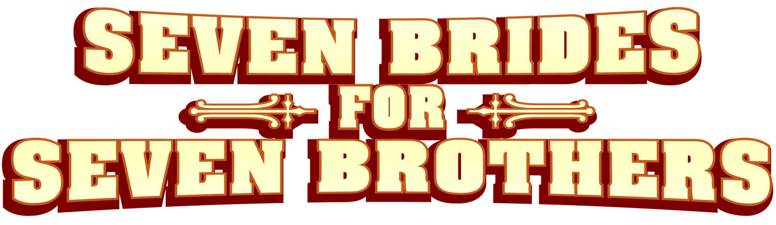
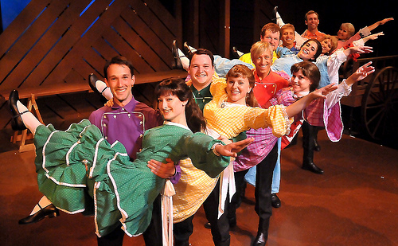
Our story begins with a musical…
In 1981, I injured my back in high school
Source: Beef and Boards Dinner Theater, Indianapolis

Slide 3
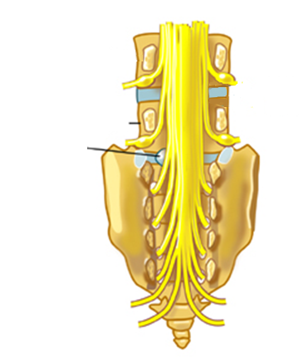
And continues with an L5-S1 injury
1981 – Sciatic nerve damage
1984 – Left leg starts jumping
1999 – Bulge revealed by MRI
2003 – Cured back pain with pilates
But…RLS sensation remained
L5
L5-S1 disc bulge

Slide 4
What is Restless Legs Syndrome (RLS)?
Uncomfortable/unpleasant sensation in legs
Often with periodic limb movements of sleep (PLMS)
Symptoms usually worse at night
Affects 7–10% of the population

Slide 5
Restless Legs Syndrome and me
Had it since my early 20’s
Diagnosed in 2001
Rx history
  2002 to 2012: Clonazepam 0.5 mg/day
  2005: Requip 1 mg/day
  2012 to present: Mirapex 0.25 mg/day

Slide 6
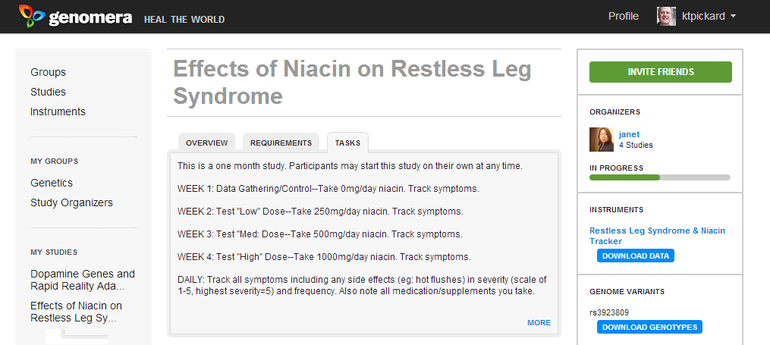
How did I get started with QS?
Genomera – Effects of Niacin on RLS
Source: genomera.com/studies/effects-of-niacin-on-restless-leg-syndrome

Slide 7
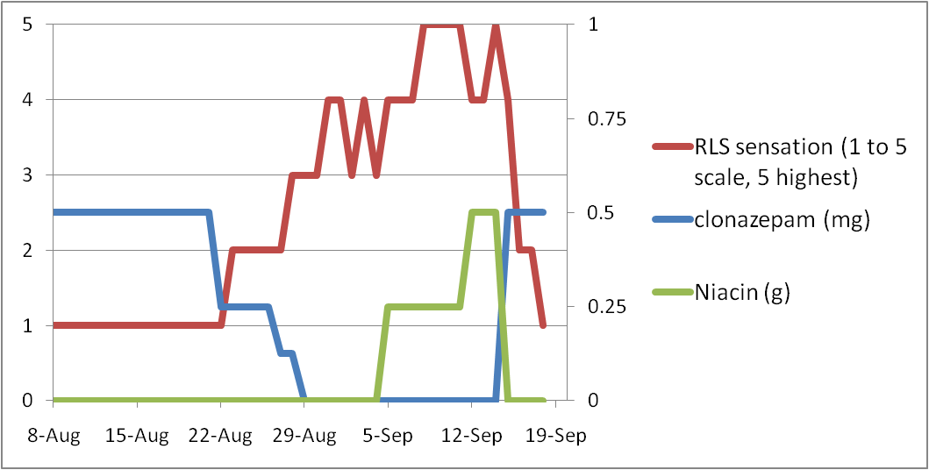
Results: RLS Study #1 (Sept 2011)
Source: bit.ly/pT1zok

Slide 8
Results: RLS Study #1 (Sept 2011)
Niacin (0.5g/day) to control RLS
Niacin did not improve my RLS
I talked with my doctor
  “Let’s check your ferritin level”
  Range: 26–388 ng/mL for males
  My ferritin: 14 ng/mL

Slide 9
Then what happened?
Started daily iron supplement
  Ferrous gluconate (27 mg elemental Fe)
Ferritin level
  14 ng/mL (Sep 2011)
  30 ng/mL (Nov 2011)
  65 ng/mL (Sep 2012)
  Fingers no longer cold!
Energy level vastly improved

Slide 10
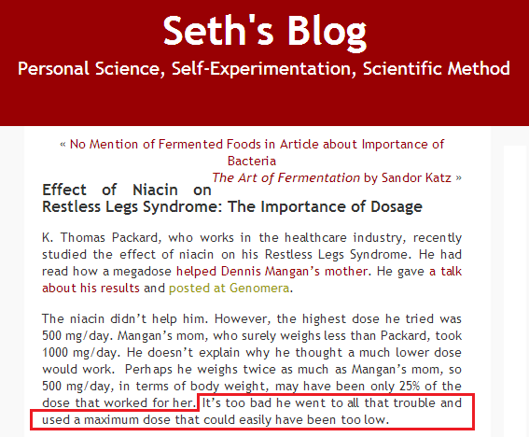
So, why do this again?
Source: http://blog.sethroberts.net/2012/06/22/genomera-study-about-effect-of-niacin-on-restless-legs-syndrome

Slide 11

Study #2: New RLS/niacin protocol
0 to 2g/day niacin over six weeks
Taper clonazepam at the end
Track “flush,” RLS and PLMS severity as before
Niacin – Vitamin B3

Slide 12
Differences from Study #1
Higher dose of niacin (2g vs 0.5g)
Used “flush free” niacin
  Niacin vs Inositol hexanicotinate
Reduce clonazepam after niacin ramp-up

Slide 13
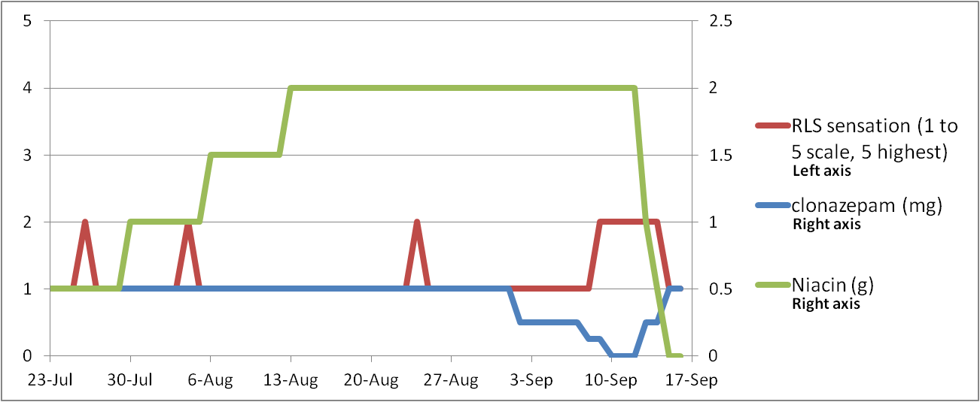
Results: Better, but it did not work.

Slide 14
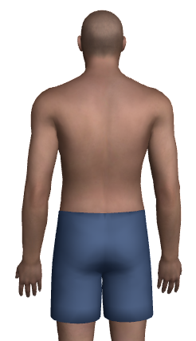
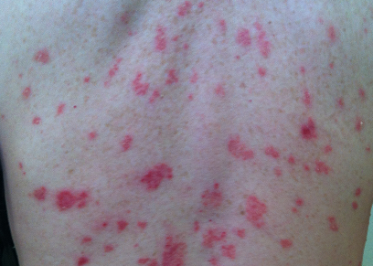
Niacin Pros and Cons
Pros
Cons
Minor improvement in mental acuity
Greater body awareness
Potential natural alternative to meds
RLS did not disappear
Easily awakened
Psoriasis flared up

Slide 15
What did I learn?
Protocols are important
Niacin is not recommended for psoriatics
Normal ferritin and/or niacin may have lessened RLS severity
QS can be uncomfortable

Slide 16
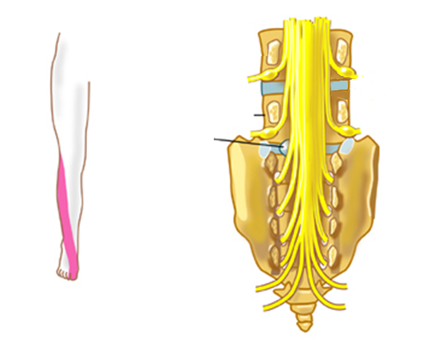
What else did I learn?
Talked with doctor about results
Started Mirapex (Sept 2012)
After 30 years, sciatic nerve feeling returns
L5
L5-S1 disc bulge
Sciatic Nerve S1
The journey was worth it.

Slide 17

Questions?
KT Pickard
@kt_pickard
linkedin.com/in/ktpickard
genomedad.com
Disclosure statement: Nothing to disclose

