Slide 1
Crowdfunding Personal Genomics
K. Thomas Pickard (KT)
Co-founder, StartCodon
SLAS2016
January 27, 2016

Slide 2
Topics
Warm-up
Crowdfunding for science
DIY genomics
Data sharing

Slide 3
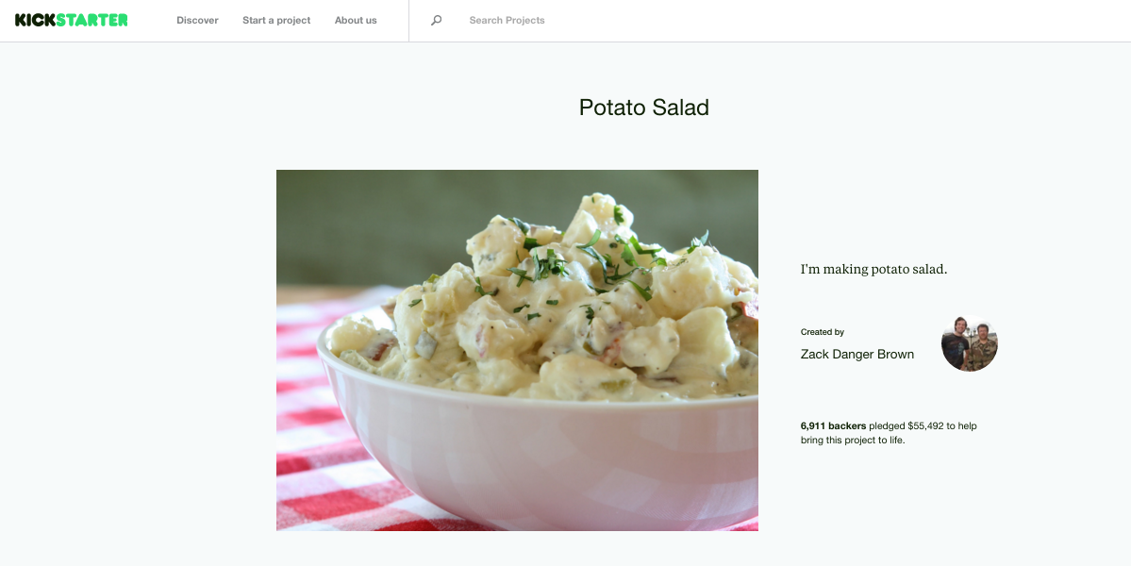
What are we talking about?
Source: https://www.kickstarter.com/projects/zackdangerbrown/potato-salad

Slide 4
What are we talking about?

Slide 5
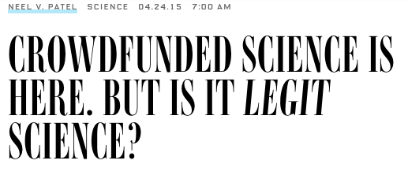
Source: http://www.wired.com/2015/04/crowdfunded-science-legit-science/

Slide 6
Gartner 2015 Hype Cycle
Citizen Data Science
Source: http://www.gartner.com/newsroom/id/3114217

Slide 7
Where is it going?
Source: http://www.forbes.com/sites/chancebarnett/2015/06/09/trends-show-crowdfunding-to-surpass-vc-in-2016

Slide 8

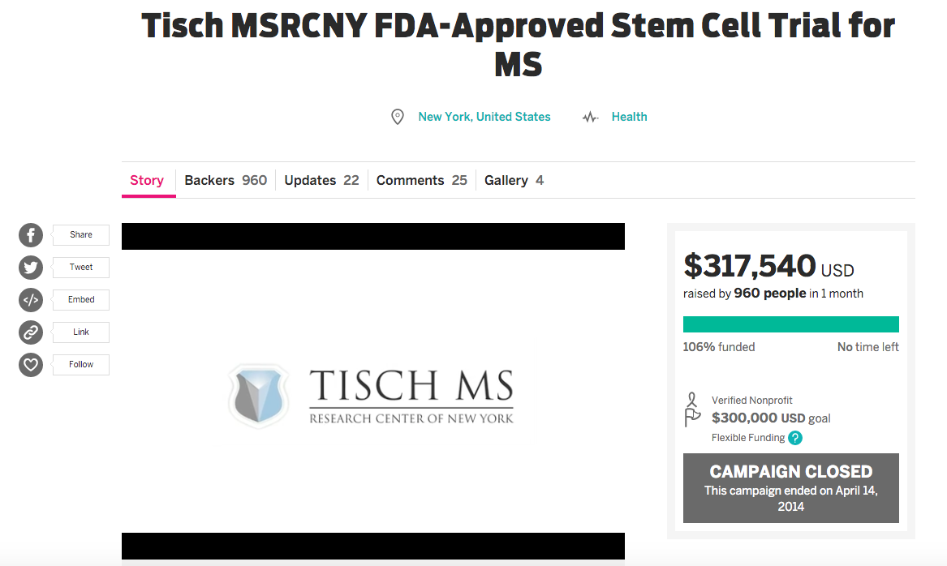
Successful campaigns
Source: https://www.indiegogo.com/projects/tisch-msrcny-fda-approved-stem-cell-trial-for-ms#/

Slide 9
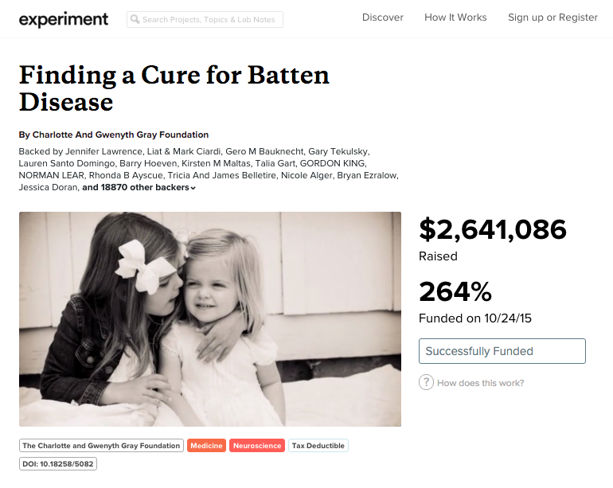
Successful campaigns
Source: https://experiment.com/projects/finding-a-cure-for-batten-disease

Slide 10
Let’s talk about crowdsourcing
Crowd
Process
You
Research!
Sources:
  https://www.researchgate.net/profile/Martin_Schader/publication/216184482_Managing_the_Crowd_Towards_a_Taxonomy_of_Crowdsourcing_Processes/links/0c960526ad27480ea9000000.pdf
  http://citeseerx.ist.psu.edu/viewdoc/download?doi=10.1.1.371.9949&rep=rep1&type=pdf

Slide 11
What it was…
Publish or perish

Slide 12
What it is…
Get Visible or Vanish

Slide 13
Let’s get started…

Slide 14

Crowdfunding sites for science

Slide 15
How they work
Fixed fee
Percentage (5-10%)
Better than indirect costs

Slide 16
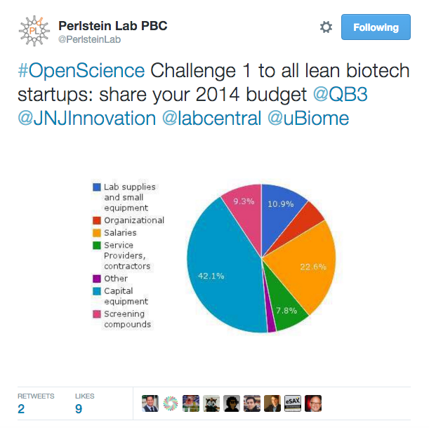
About transparency
Sources:
  http://www.plab.co/blog/january-tweets/
  https://www.kimbia.com/need-feedback-crowdfunder-bill-rights/

Slide 17
DIY Sequencing
Raise money
Find a sequencing company
Contact doctor and order blood draw
Show up at lab with kit
Overnight samples
Download data
Analyze results
Give talk

Slide 18
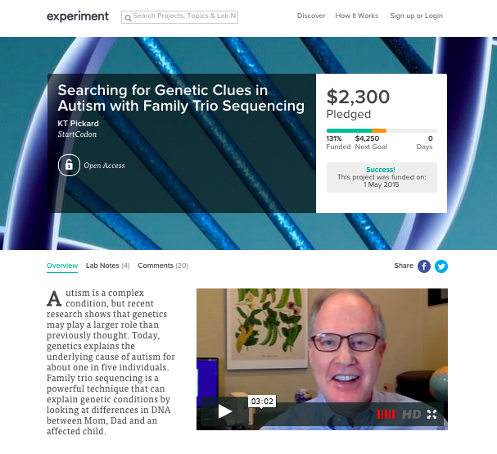
1. Launch a campaign
Source: https://experiment.com/projects/searching-for-genetic-clues-in-autism-with-family-trio-sequencing

Slide 19
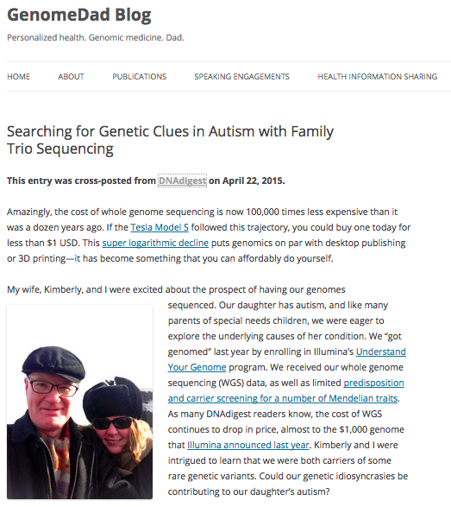
Blog about it
Raised $1,750 in less than 24 hours
Source: http://genomedad.com

Slide 20




2. Find a sequencing company

Slide 21
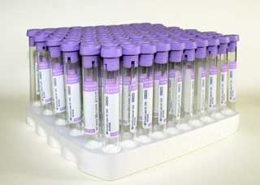
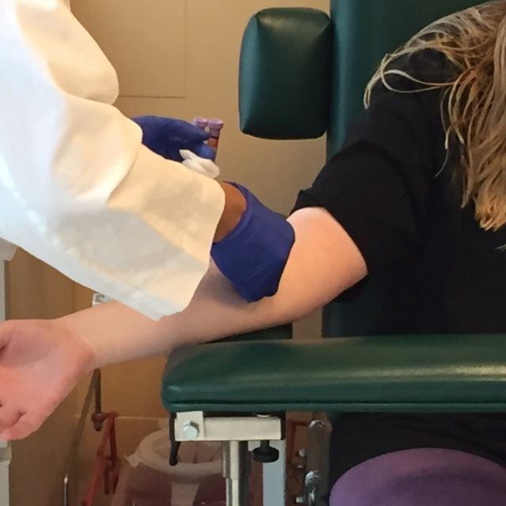
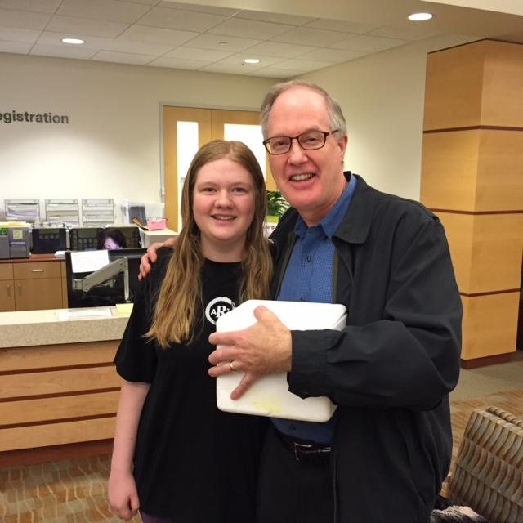
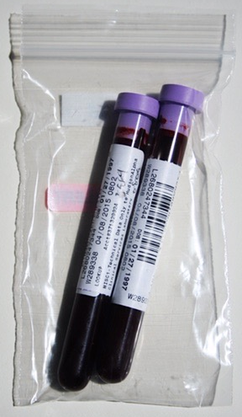
3. Blood draw
4. Make a kit
5. Ship it!
Source: http://www.amazon.com/gp/product/B0015TEDS0

Slide 22
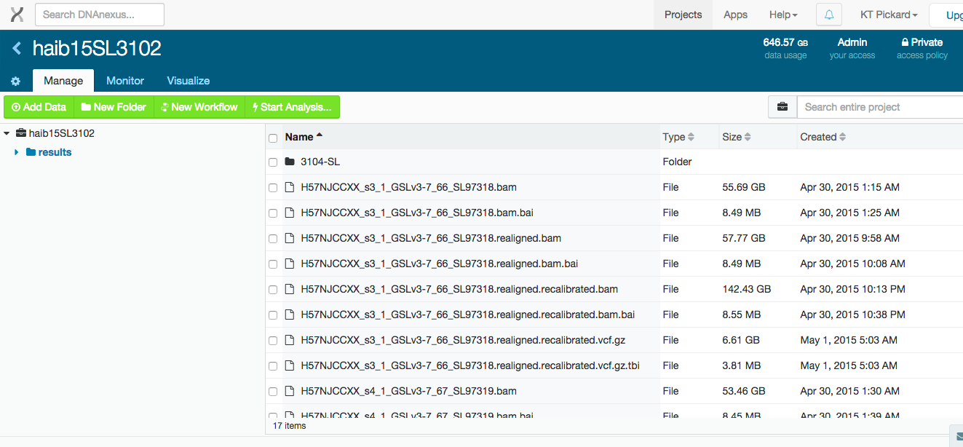
6. Download data
About 325GB per person (FASTQ, BAM, VCF, indexes)
Amazon to Amazon copy: 10GBytes/hour
Amazon to Home (150Mbits/sec): 4GBytes/hour
Source: https://www.dnanexus.com/

Slide 23
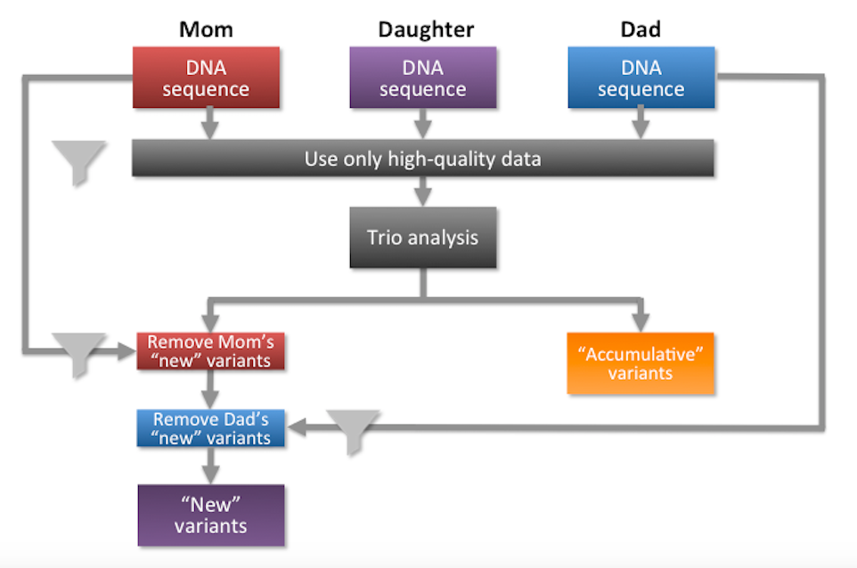
7. Analyze results: Family Trio Sequencing

Slide 24

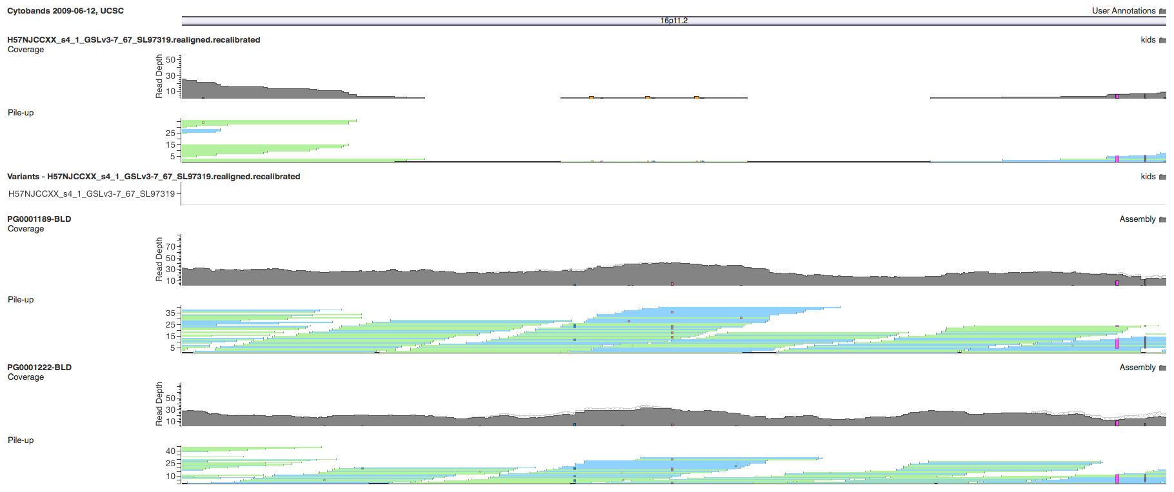
Proband
Dad
Mom
Location: 16p11.2 (deletion)

Slide 25
Take away: It’s the story
Email most effective
Social media important
Get media attention
Updates
Thank you’s
No bucks, no Buck Rogers
Source: http://www.imdb.com/title/tt0086197/

Slide 26
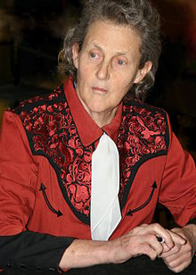
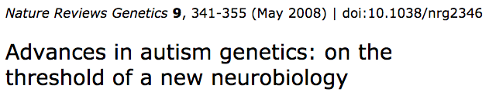
Autism spectrum disorders
Disease prevalence:
  World: 1%
20% explained by genomics
  U.S. 2M people → > 6 types → 300k per type
Autistic activist Temple Grandin
Sources:
  http://www.cdc.gov/ncbddd/autism/documents/asd_prevalence_table_2013.pdf
  http://www.ncbi.nlm.nih.gov/pmc/articles/PMC2756414/

Slide 27
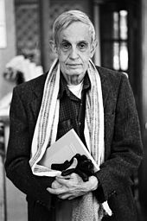
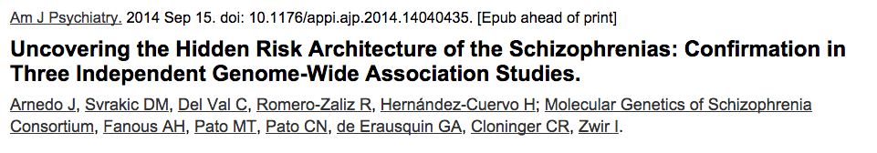
Schizophrenia
Disease prevalence:
  World: 1% (with little variation)
Disease types: 7 or more
U.S. 3.5M people → 7 types → 500k per type
Nobel laureate John Nash
Source: http://www.ncbi.nlm.nih.gov/pubmed/25219520

Slide 28
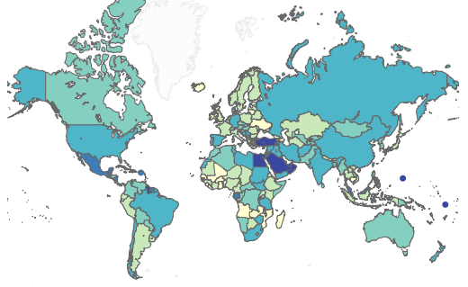
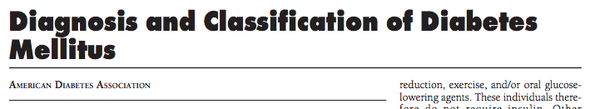
Diabetes
Disease prevalence:
  World: 4% to 40%
  U.S.: 10%
Disease types: 30+
U.S. 30M people → 30 types → 1M per type
Sources:
  http://care.diabetesjournals.org/content/29/suppl_1/s43.full.pdf
  http://healthintelligence.drupalgardens.com/content/prevalence-diabetes-world-2013

Slide 29
Common disease → rare disease
300k autism spectrum disorder patients
    50 patients per hospital → 1 in 1,000
500k schizophrenic patients
    80 patients per hospital → 1 in 625
1M diabetes patients
    170 patients per hospital → 1 in 300
→ Rare disease: 1 in 1,500
Source: http://www.cdc.gov/datastatistics/

Slide 30
Summary
Crowdfunding is exploding
Get visible or vanish
Tell your story
Share your findings

Slide 31
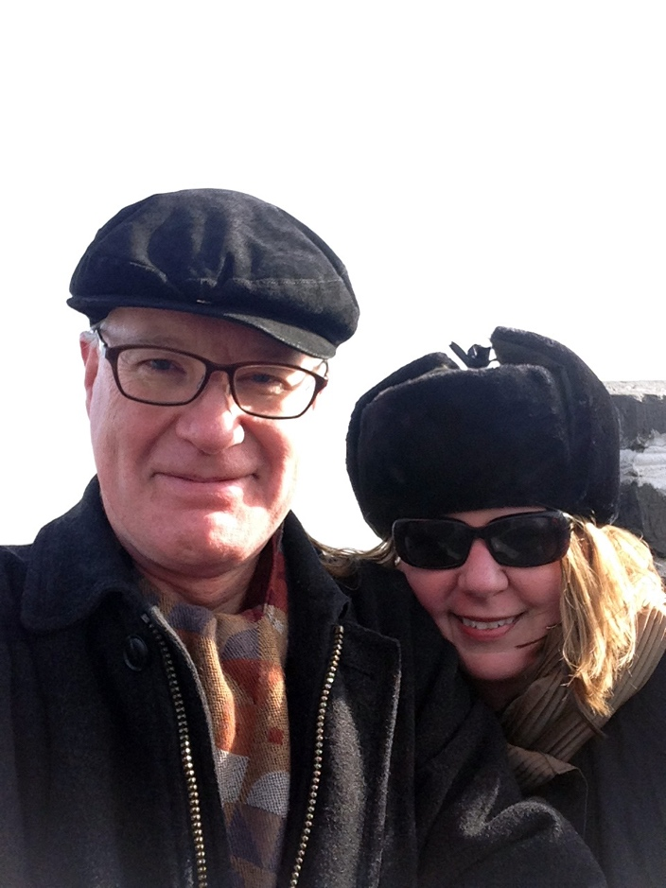

Thank you
KT Pickard
ktpickard [at] startcodon.org
@kthomaspickard
www.linkedin.com/in/kthomaspickard
Blog: www.genomedad.com

