Slide 1
Our -Omics Odyssey
K. Thomas Pickard
Founder, StartCodon
2015 TCGC Short Course
Personal Genomics: Variant Analysis and Interpretation with Public Data
June 22, 2015

Slide 2
Topics
Getting started
DIY sequencing
Data sharing

Slide 3
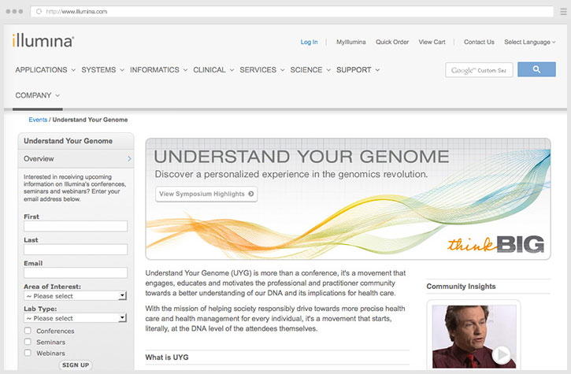
Getting started for $5,000

Slide 4
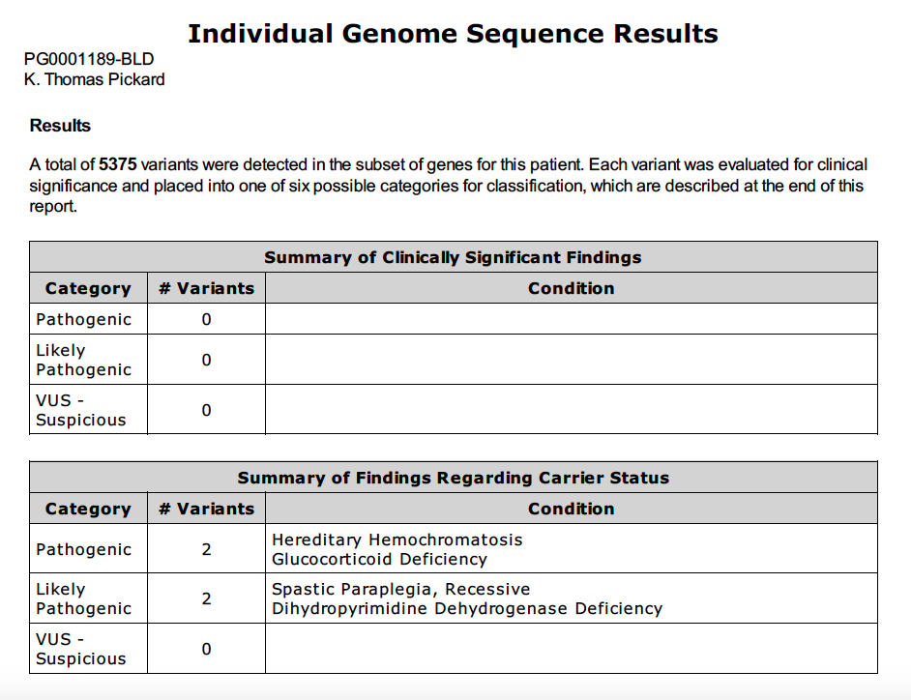
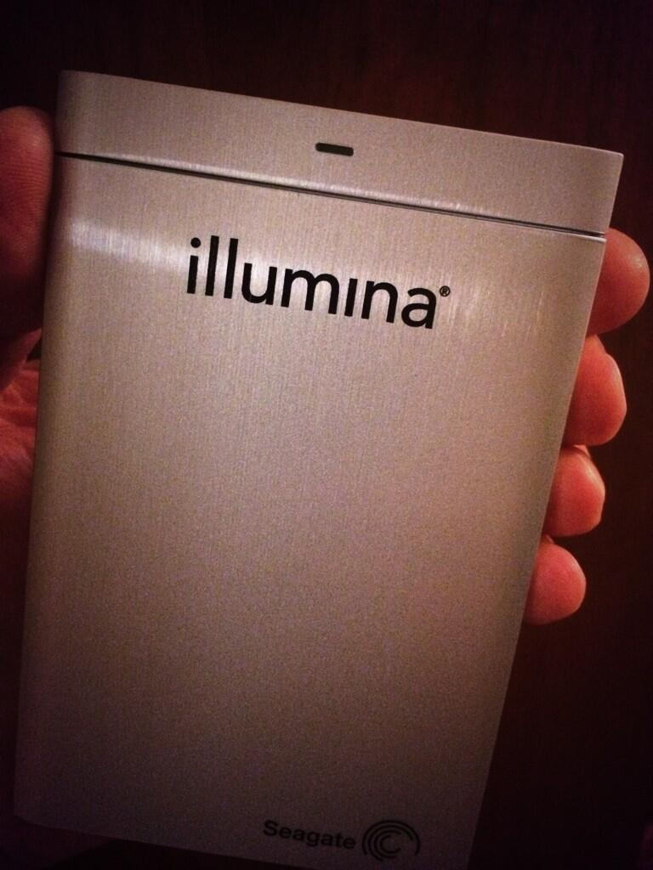
Which is more valuable?
The report or the data?

Slide 5
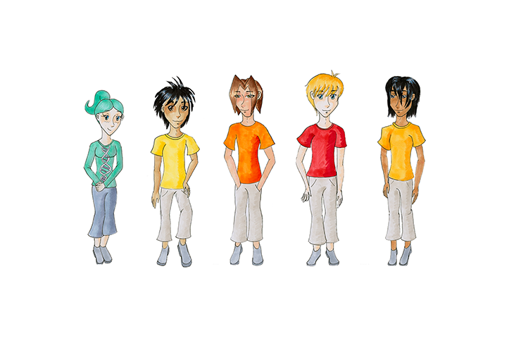
Now what?
Adult-aged daughter with autism
Family trio sequencing
Search for genetic clues
Genomics provides clues to autism for about 1 in 5 individuals
Source: http://www.ncbi.nlm.nih.gov/pmc/articles/PMC2756414/

Slide 6
DIY Sequencing
Raise money
Find a sequencing company
Contact doctor and order blood draw
Show up at lab with kit
Overnight samples
Download data
Analyze results
Give talk

Slide 7
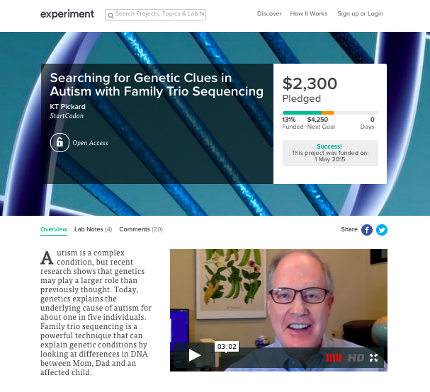

1. Launch a campaign
Source: https://experiment.com/projects/searching-for-genetic-clues-in-autism-with-family-trio-sequencing

Slide 8
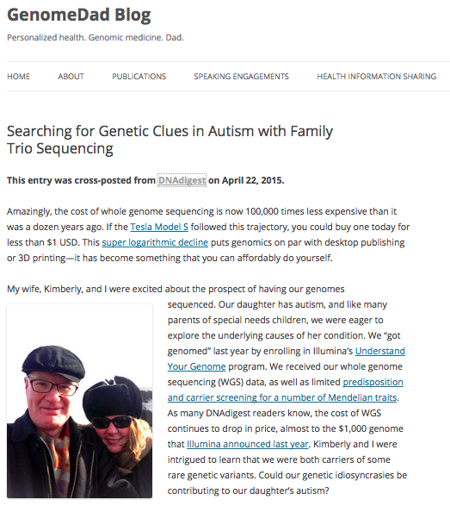
Blog about it
Raised $1,850 in less than 24 hours
Source: http://genomedad.com

Slide 9




2. Find a sequencing company

Slide 10
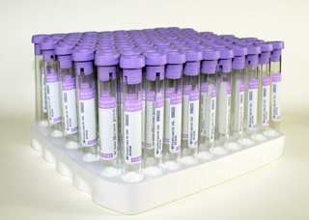
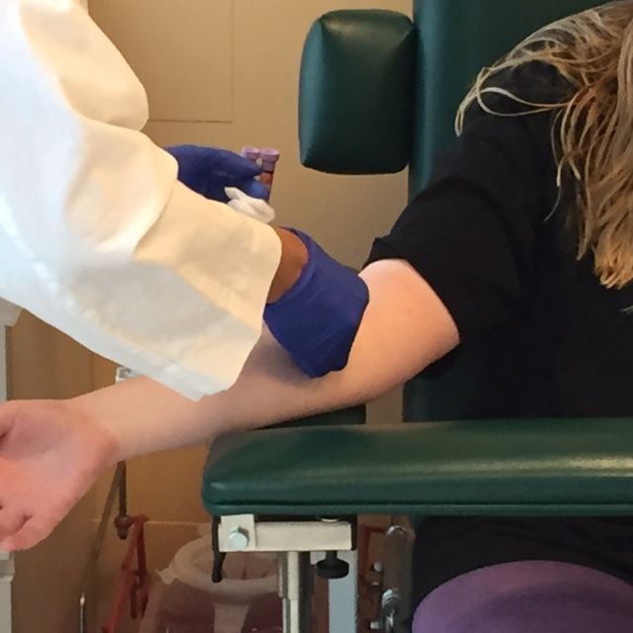
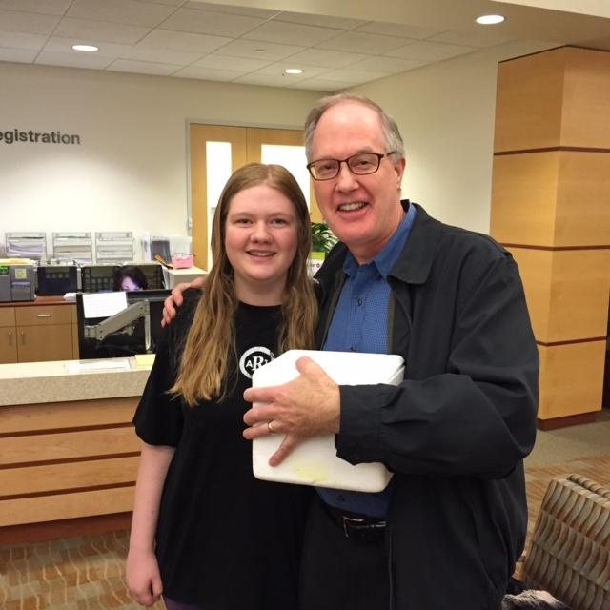
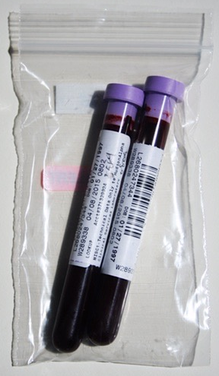
3. Blood draw
4. Make it look right and no one asks questions
5. Ship it!
Source: http://www.amazon.com/gp/product/B0015TEDS0

Slide 11
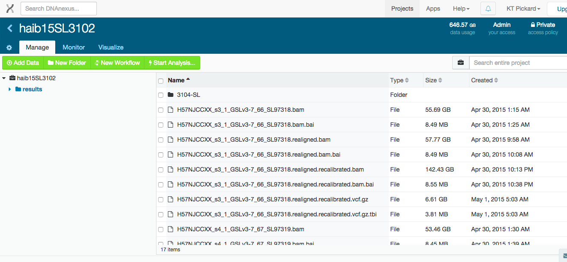
6. Download data
About 325GB per person (FASTQ, BAM, VCF, indexes)
Amazon to Amazon copy: 10GBytes/hour
Amazon to Home (150Mbits/sec): 4GBytes/hour
Source: https://www.dnanexus.com/

Slide 12
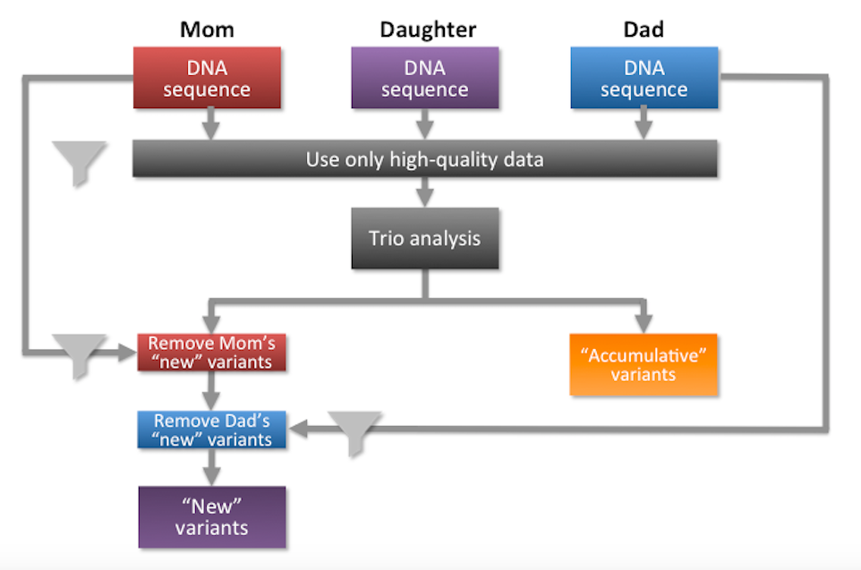
7. Analyze results: Family Trio Sequencing

Slide 13
Methods
Looked at de novo and compound hets
  52 variants total
Looked at autism gene databases
  200 – 700 genes total
Looked at autism gene “hot spots”
  16p11.2, NRXN1
Source: http://www.ncbi.nlm.nih.gov/pubmed/22228009

Slide 14

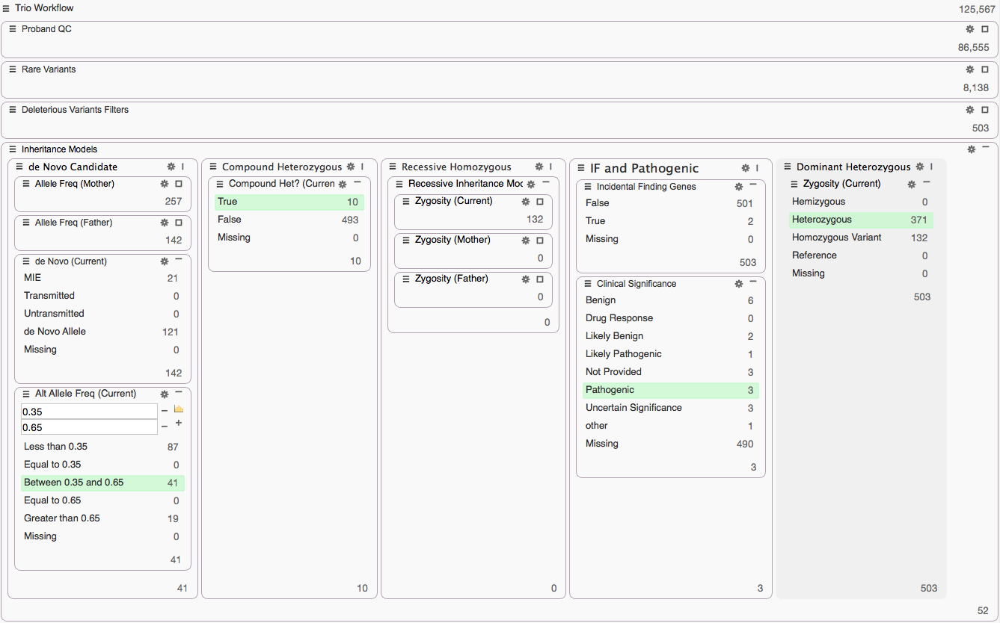

Slide 15
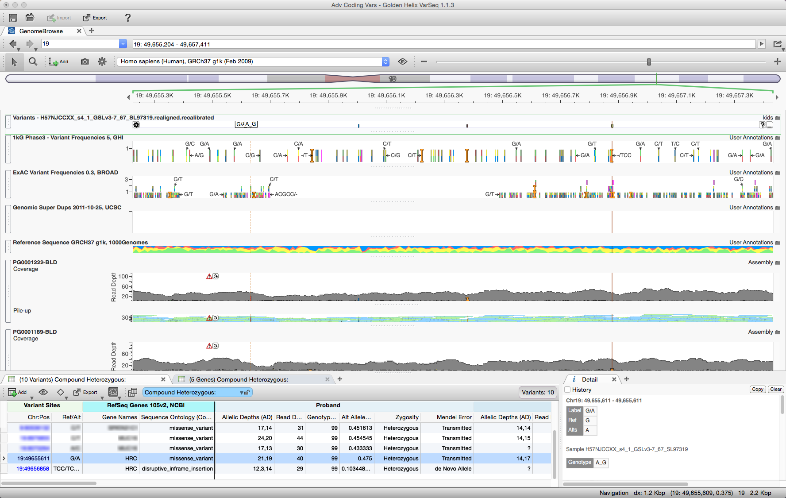
Proband
Mom
Dad
Location: HRC

Slide 16
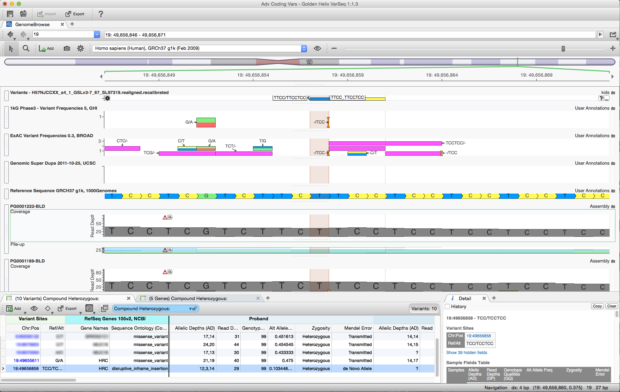
Proband
Mom
Dad
Location: HRC

Slide 17
Autism gene databases
Autworks
  http://autworks.hms.harvard.edu/
KU Autism Database
  http://wren.bcf.ku.edu/
Lancet series on autism (April 2015)
  http://dx.doi.org/10.1016/S1474-4422(15)00044-7
Simons Foundation Autism Research Initiative
  http://sfari.org/

Slide 18
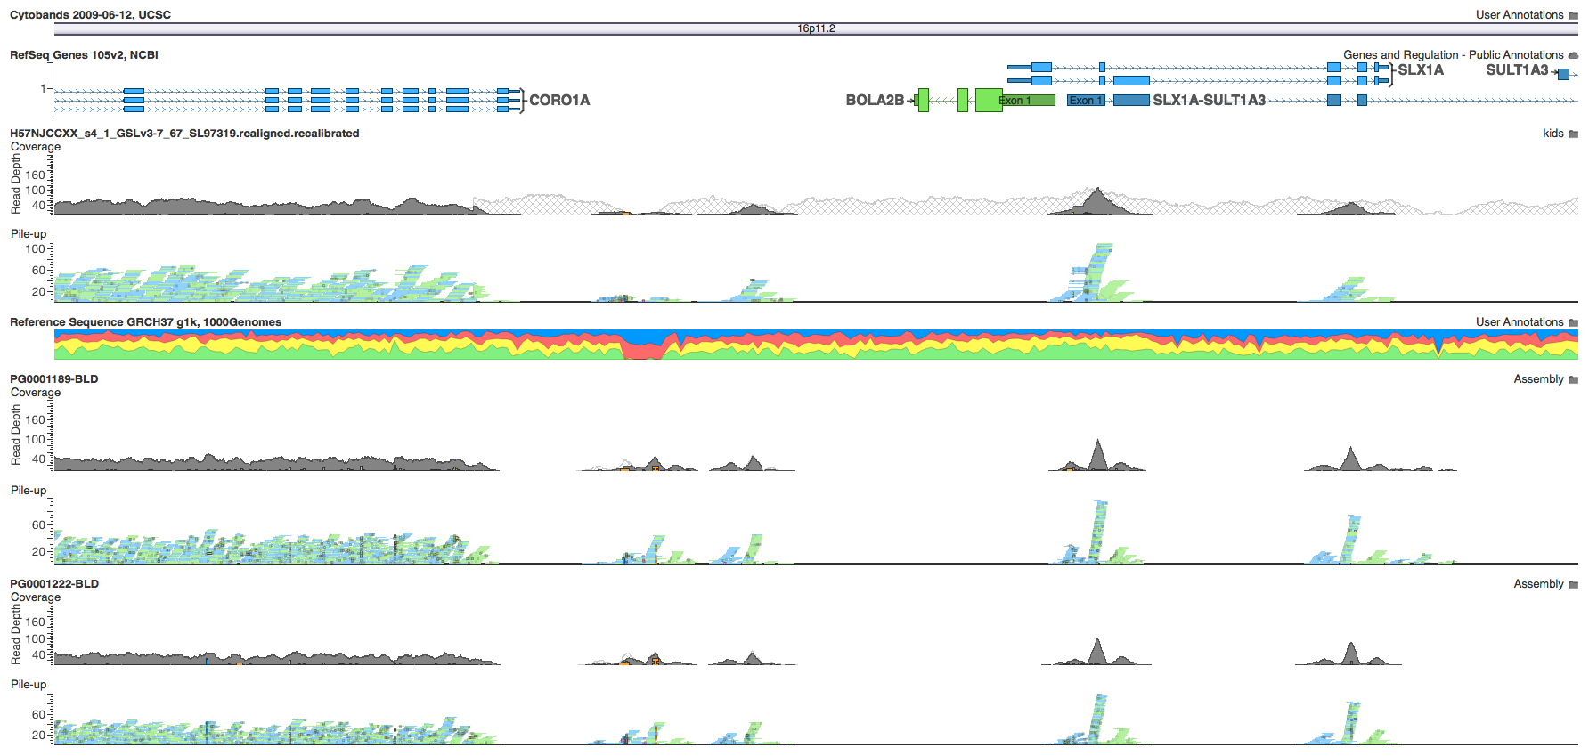
Proband
Dad
Mom
Location: 16p11.2

Slide 19
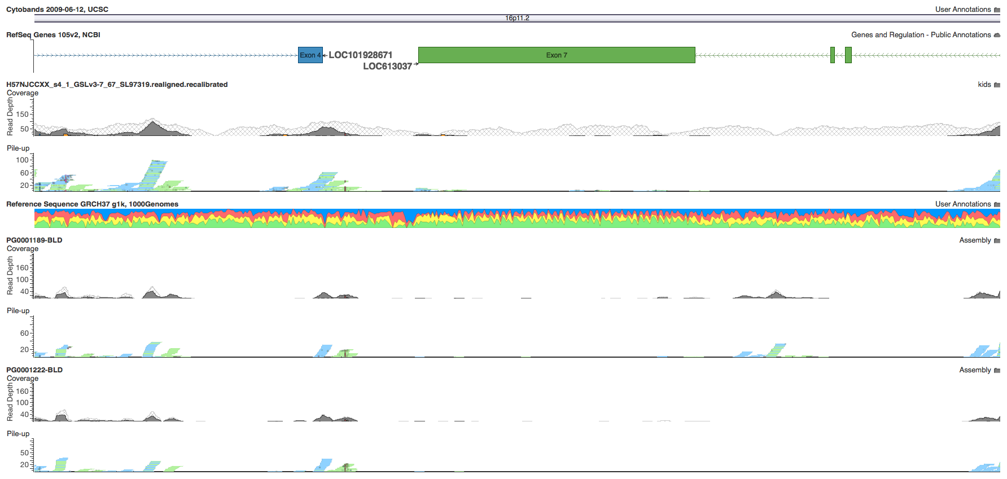
Proband
Dad
Mom
Location: 16p11.2

Slide 20
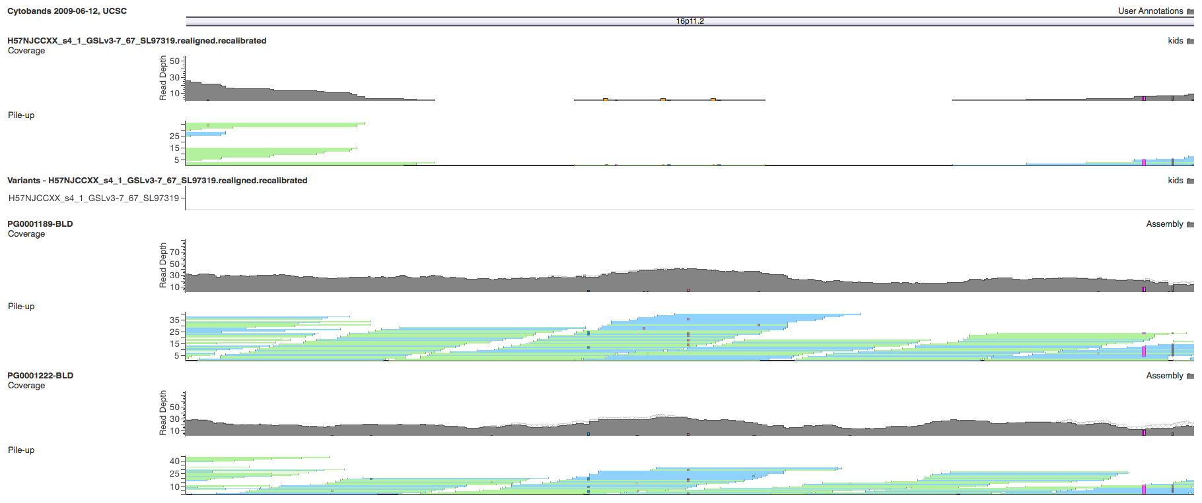
Proband
Dad
Mom
Location: 16p11.2 (deletion)

Slide 21
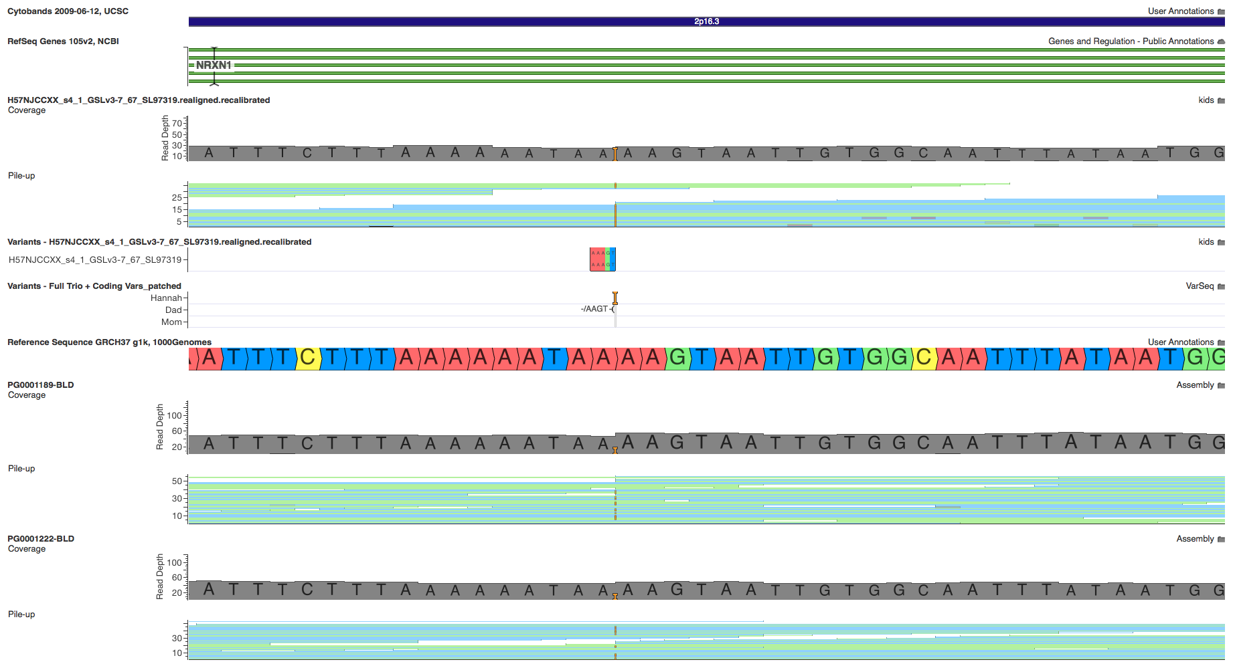
Proband
Dad
Mom
Location: NXRN1 (insertion)

Slide 22
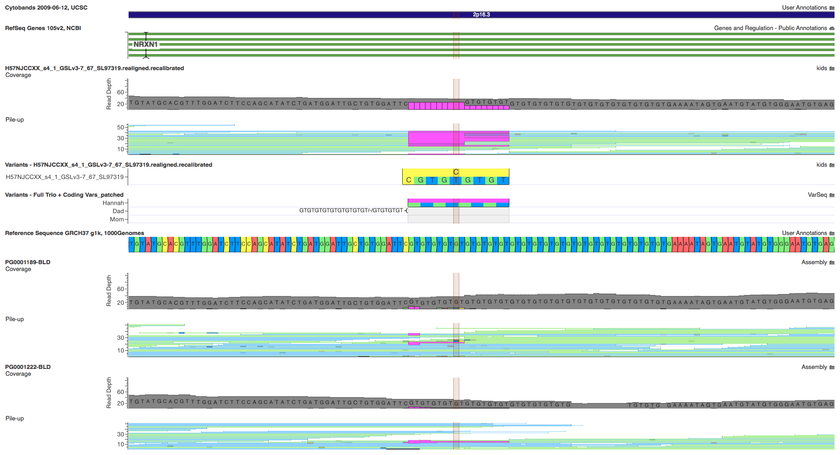
Proband
Dad
Mom
Location: NXRN1 (deletion)

Slide 23
Take home lessons / to-dos
Run trio samples through the same pipeline
Beware of false positive de novo variants
Pay attention to carrier status
Perform CNV analysis

Slide 24
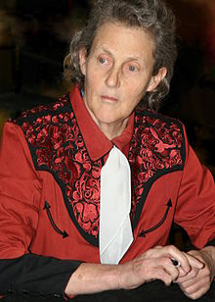
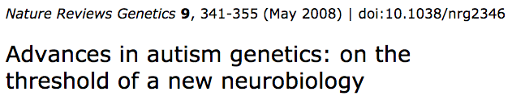
Autism spectrum disorders
Disease prevalence:
  World: 1%
20% explained by genetics
  U.S. 2M people → > 6 types → 300k per type
Autistic activist Temple Grandin
Sources:
  http://www.cdc.gov/ncbddd/autism/documents/asd_prevalence_table_2013.pdf
  http://www.ncbi.nlm.nih.gov/pmc/articles/PMC2756414/

Slide 25

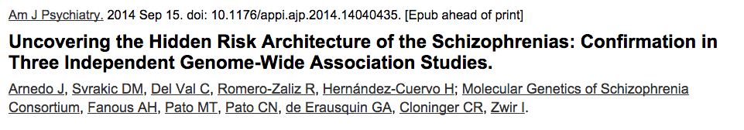
Schizophrenia
Disease prevalence:
  World: 1% (with little variation)
Disease types: 7 or more
U.S. 3.5M people → 7 types → 500k per type
Nobel laureate John Nash
Source: http://www.ncbi.nlm.nih.gov/pubmed/25219520

Slide 26
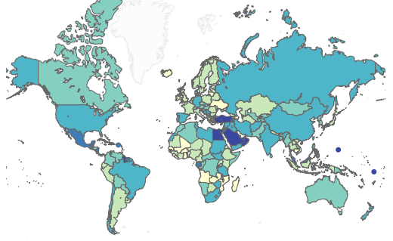
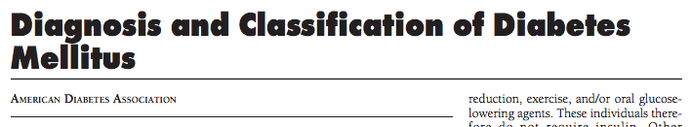
Diabetes
Disease prevalence:
  World: 4% to 40%
  U.S.: 10%
Disease types: 30+
U.S.: 30M people → 30 types → 1M per type
Sources:
  http://care.diabetesjournals.org/content/29/suppl_1/s43.full.pdf
  http://healthintelligence.drupalgardens.com/content/prevalence-diabetes-world-2013

Slide 27
Common disease → rare disease
300k autism spectrum disorder patients
    50 patients per hospital → 1 in 1,000
500k schizophrenic patients
    80 patients per hospital → 1 in 625
1M diabetes patients
    170 patients per hospital → 1 in 300
→ Rare disease: 1 in 1,500
Source: http://www.cdc.gov/datastatistics/

Slide 28


Making genomes useful
GA4GH: 320+ organizations enabling genomic data sharing
Beacon Project: Test the willingness of international sites to share data
Source: https://genomicsandhealth.org/

Slide 29
Summary
Personal genomics is real
Think “homebrew computers” in the mid-‘70s
Some dark alleys, but not all
Data sharing is critical for insights

Slide 30

Special Thanks
For the use of

Slide 31
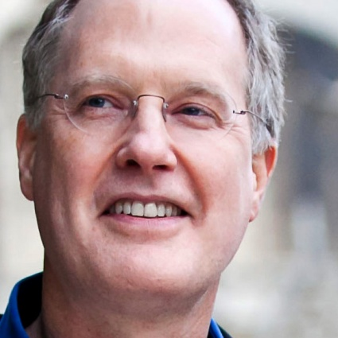

Thank you
K. Thomas Pickard
ktpickard [at] startcodon.org
@kthomaspickard
www.linkedin.com/in/kthomaspickard
Blog: www.genomedad.com

